Slide 1


Superstore Sales Dashboard
Analyzing Sales Trends and Business Opportunities

Slide 2
Executive Summary :
• Total sales amount to $1.97M over the analyzed period.
• Sales growth rate stands at 0.47, indicating moderate improvement.
• South Region leads with 32.01% of total sales, followed by West (29.58%).

Slide 3
Dashboard Objectives :
• Provide a comprehensive view of sales performance across regions and categories.
• Identify top-performing regions, products, and customers.
• Highlight actionable insights to drive business growth.
• Monitor sales trends and seasonal patterns.

Slide 4
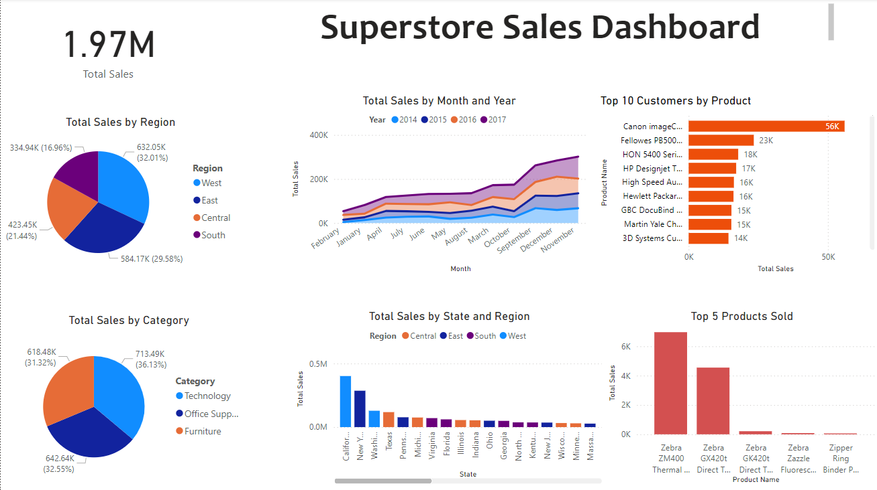
Basic Visualizations :

Slide 5
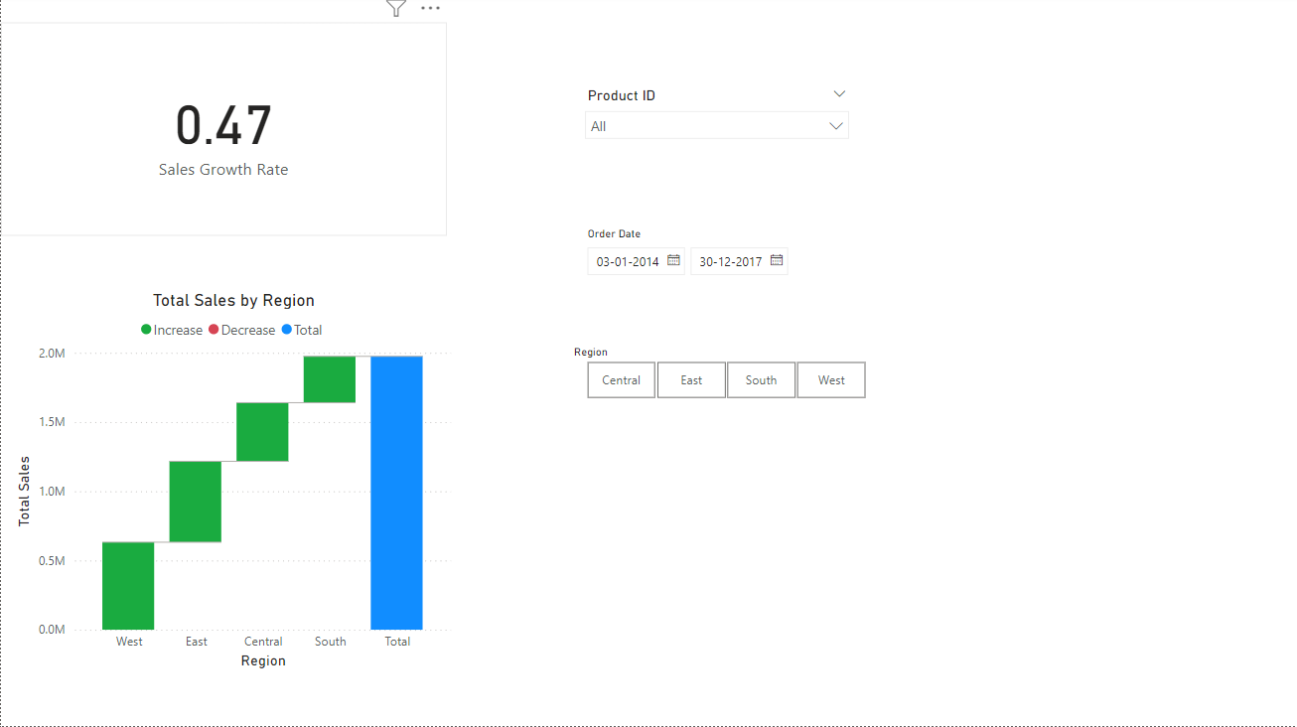
Advanced Sales Analysis :

Slide 6

Data Overview :
• Time Period: January 2014 to December 2017.
• Key Metrics: Total Sales, Growth Rate, Regional and Product Performance.
• Data Segmentation: By Region, Product Category, Customer, and Time.

Slide 7
Sales Performance Overview :
• Total sales: $1.97M with steady growth across years.
• Highest sales observed during Q4 (October–December).
• Significant peaks in December, showcasing seasonal demand.

Slide 8
Regional Analysis :
• South Region leads with 32.01% of total sales.
• West and Central regions contribute 29.58% and 21.44%, respectively.
• East Region accounts for 16.96% of sales.

Slide 9
Product Insights :
• Technology is the top-performing category (36.13%).
• Furniture (32.55%) and Office Supplies (31.32%) follow closely.
• Canon imageClass leads product sales with 56K.

Slide 10
Customer Insights :
The top customer for sales is associated with the product Canno ImageCLASS with total sales of 56K.
Other notable contributors include products like Fellowes PB500,HON 5400 Series,and HP.
DesignJet with sales ranging from 15K to 23K.

Slide 11
Actionable Recommendations :
• Expand operations in South and West regions to leverage high sales potential.
• Increase focus on Technology products to maintain category dominance.
• Develop targeted marketing strategies for high-value customers.
• Optimize inventory for seasonal demand spikes in Q4.

Slide 12




THANK YOU !

